Slide 1
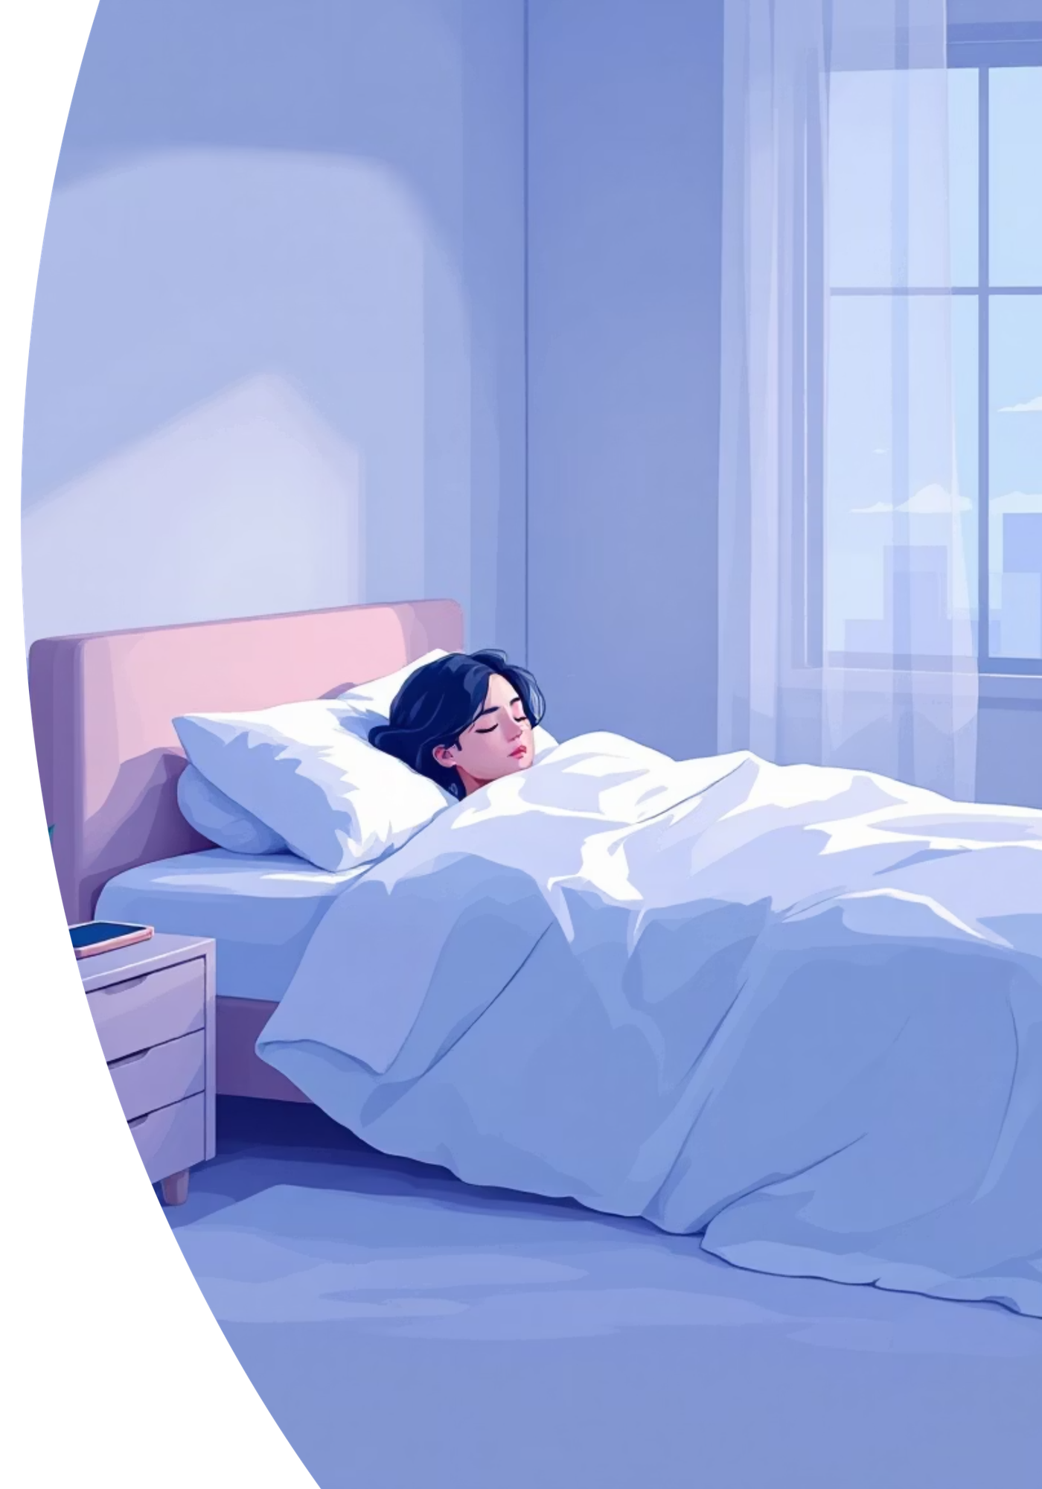
SLEEP FENCE
“Guarding Your Sleep,
One Screen at a Time”
Pravallika, A.Sravanthi,
Vaishnavi. M, Vaishnavi. P
B. Sc MSDs - III year

Slide 2
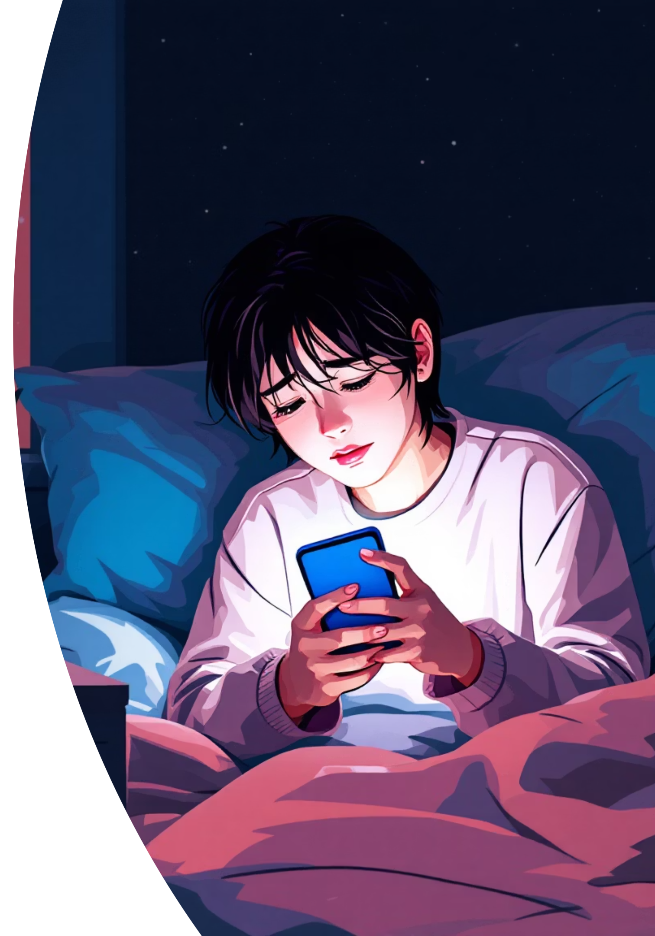

The Digital Dilemma
Eroding Sleep Quality
Ineffective Warnings
Excessive late-night phone use is a primary culprit behind reduced sleep quality and diminished daily productivity, impacting overall well-being.
Current solutions, primarily basic app warnings, are easily bypassed or ignored, failing to provide genuine enforcement of healthy digital boundaries.
The Need for Smart Enforcement
A truly effective solution demands an AI-based system that enforces healthy sleep habits without rigid restrictions, ensuring urgent tasks can still be addressed.

Slide 3
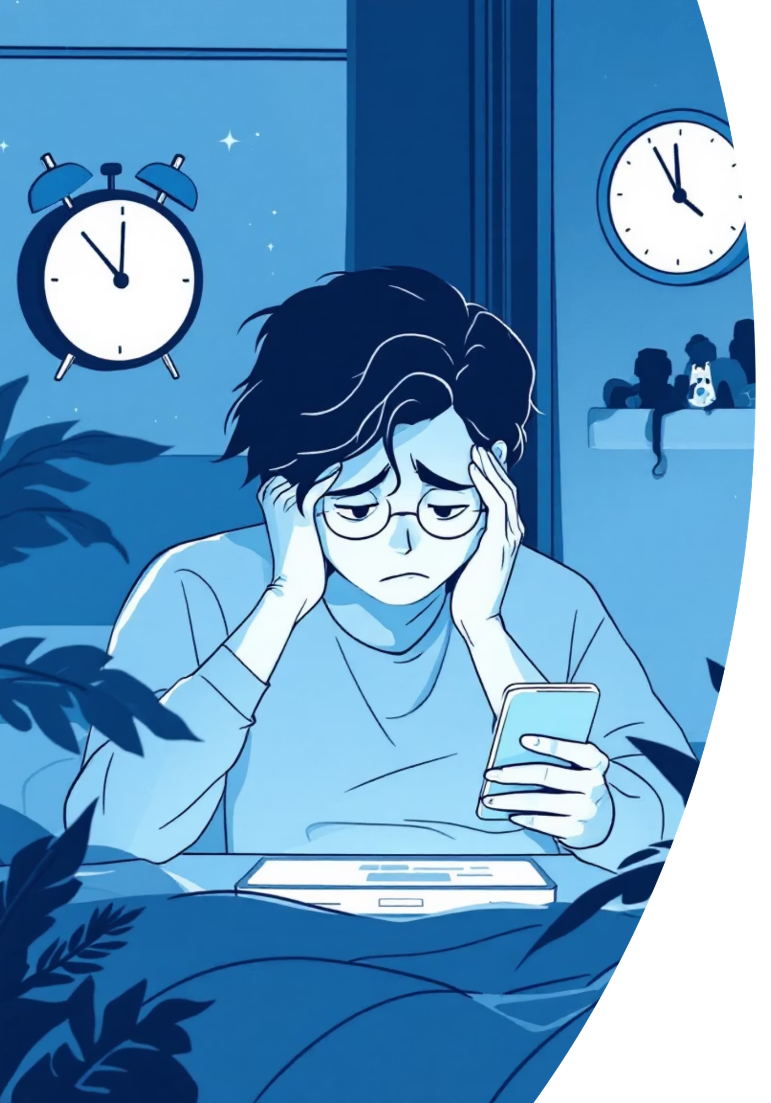
Insight: Bridging the Gap Between Intent and Action
Self-Regulation Struggles
A significant number of users acknowledge the negative impact of night-time screen use but find it incredibly challenging to self-regulate without external assistance.
The 'Ignore' Factor
Simple, passive reminders, while well-intentioned, often fall flat because they lack the necessary mechanism to prevent users from overriding their own best interests.
AI for Adaptive Enforcement
There's a clear opportunity to leverage AI not just for reminders, but for intelligent enforcement that adapts to real-life needs, allowing for emergency access while protecting sleep.

Slide 4
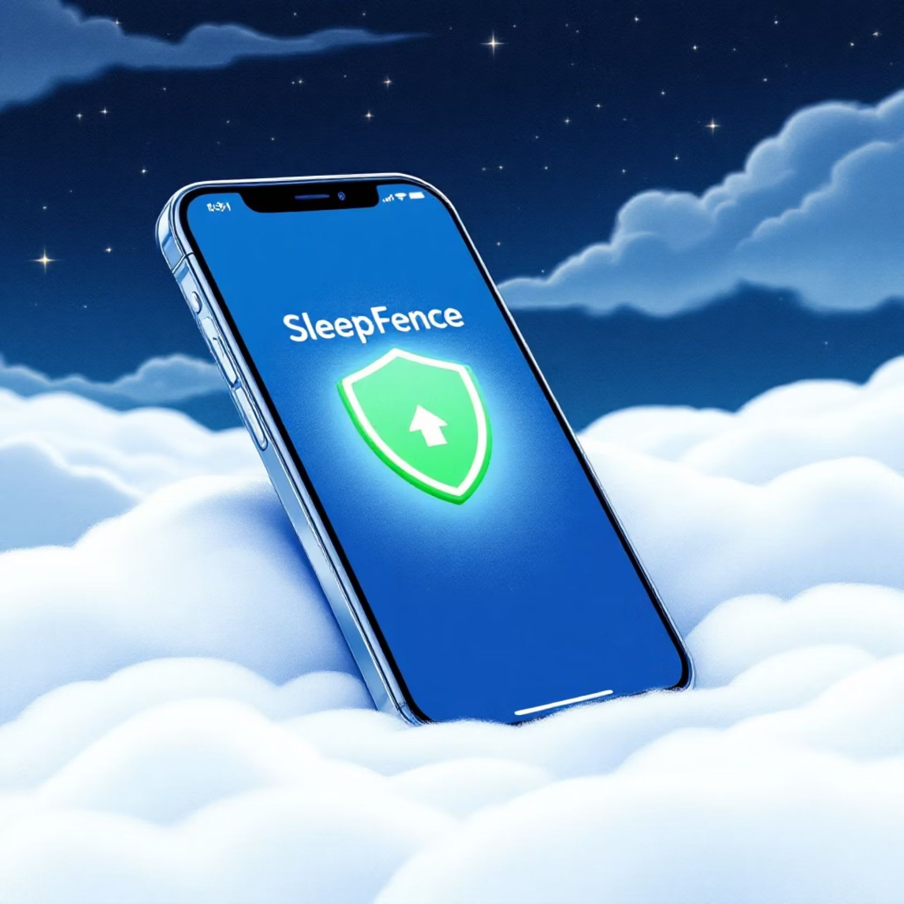
Solution: SleepFence - Intelligent Sleep Protection
SleepFence is an innovative, AI-powered mobile application designed to seamlessly integrate healthy sleep habits into your digital life. It moves beyond simple alerts to proactively manage your screen time, ensuring you get the restorative sleep you need without missing critical communications.
AI-driven enforcement at preset sleep times.
Emergency Work Mode for essential tasks.
Fosters improved sleep and daytime productivity.

Slide 5
Key Features: Engineered for Your Well-being
AI-Driven Screen off
Emergency Work Mode
Customizable Schedules
Automatically off your screen when your designated sleep schedule begins, providing a gentle yet firm nudge towards healthy rest.
A secure, temporary override allows access to specific apps for urgent tasks, ensuring you stay connected when it truly matters.
Tailor your sleep and screen-off times to fit your unique lifestyle and evolving needs, empowering personalized digital wellness.
User-Friendly Interface
Gentle Sleep Reminders
An intuitive design makes setting up and managing your sleep patterns effortless, promoting adoption and consistent use.
Proactive notifications guide you towards a consistent sleep routine, reinforcing healthy habits without being intrusive.

Slide 6

Reference Link
Link: https://my-site-coxkx9wt-sravanthiaare2.wix-vibe.com

Slide 7

Conclusion: Reclaiming Your Nights, Enhancing Your Days
1
2
Prioritizing Healthy Sleep
Optimized Productivity & Wellness
SleepFence empowers users to effortlessly maintain healthy sleep habits, reducing the impact of digital distractions on their well-being.
By intelligently managing screen time, SleepFence strikes a crucial balance, ensuring both productivity and personal wellness are prioritized.
3
Innovative AI for Digital Wellbeing
This innovative AI solution sets a new standard for digital wellbeing, offering a smart, adaptable, and effective approach to screen time management.

Slide 8

Thank You

